Slide 1


Slide 2
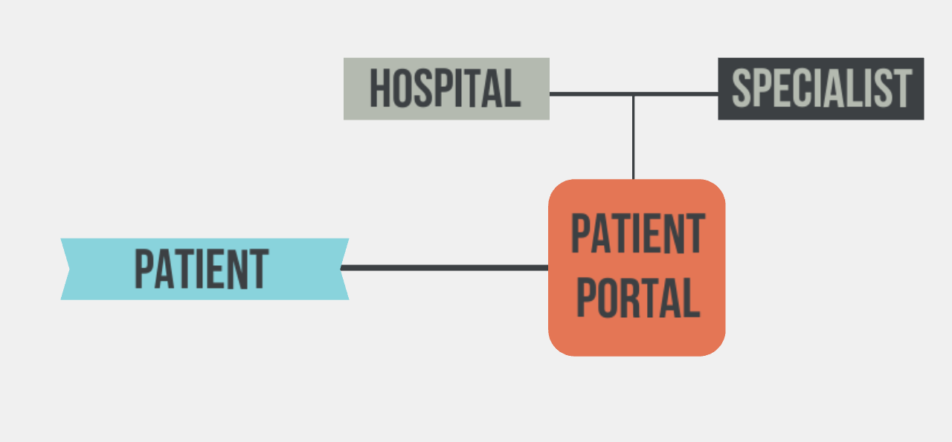

Slide 3
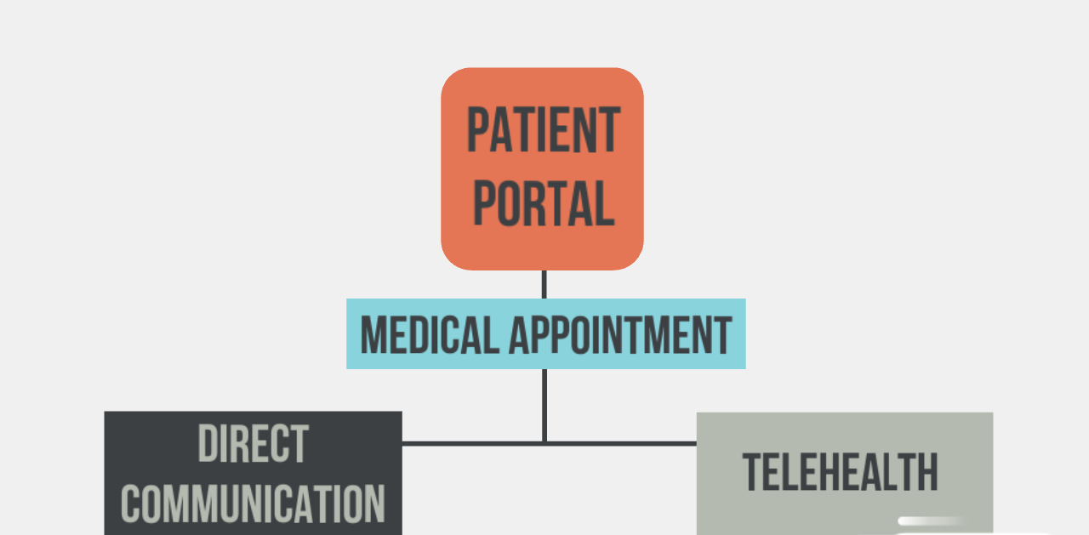

Slide 4
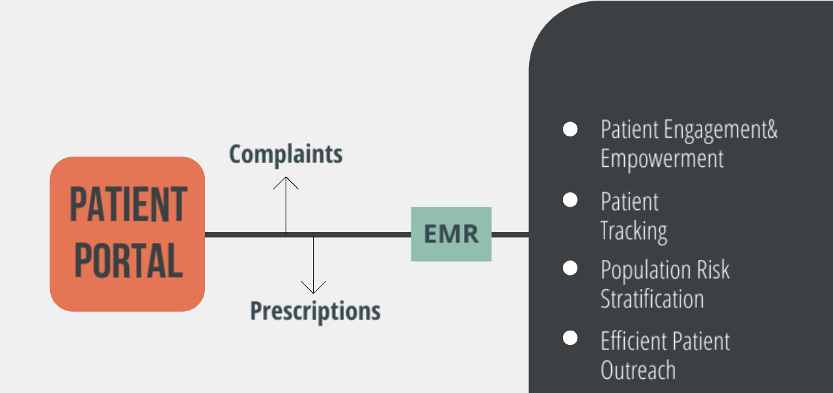

Slide 5
Click Here

Slide 6


