Slide 1
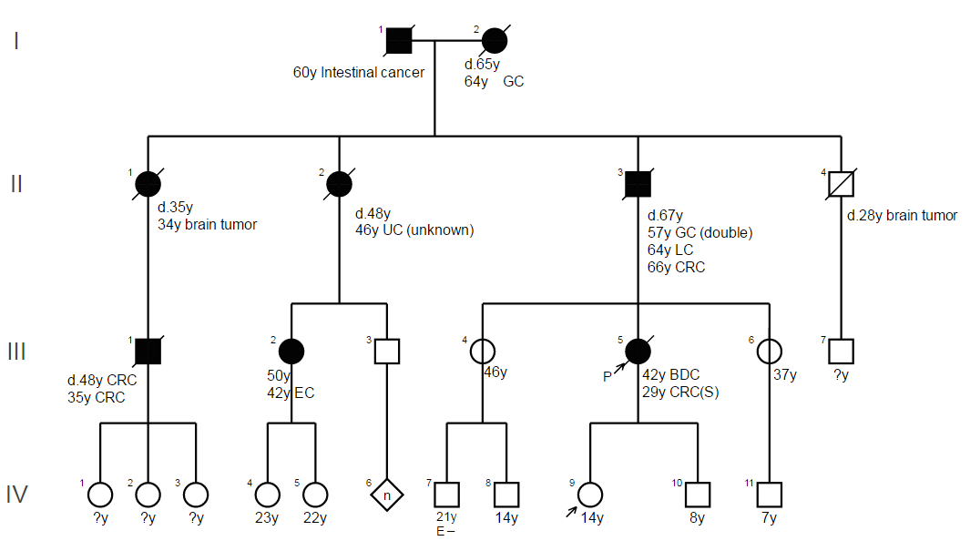
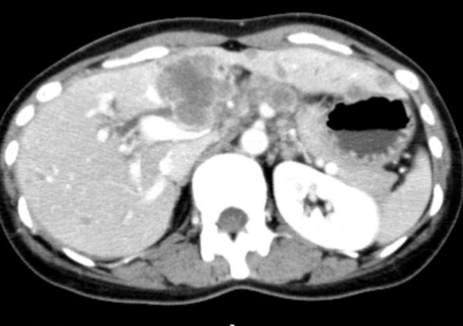
Proband [42y, female]
1st Colon ca, stage I
2nd Bile duct ca, stage IV
Notes:
This slide shows one family with Lynch syndrome.
When the proband first developed colon cancer, she was not diagnosed with Lynch syndrome. It was too late when she got the right diagnosis as Lynch syndrome, because she was suffering from bile duct cancer with multiple metastases. Unfortunately, she passed away due to the cancer.

Slide 2
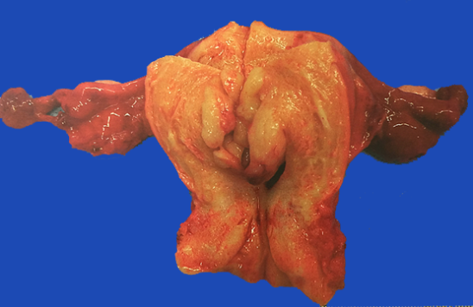
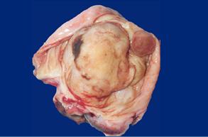
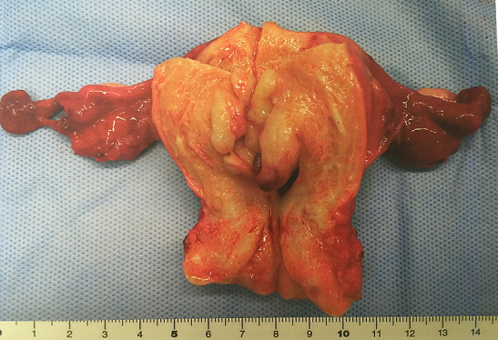
Relatives
Endometrial cancer stage Ia
1st Colon ca, stage I
2nd Bile duct ca, stage IV
Ovarian cancer stage Ia
Notes:
After her death, based on her genetic information, we confirmed that two of her sisters have Lynch syndrome, and we conducted surveillance.
We are pleased to say /that we found their endometrial and ovarian cancers at an early stage. And both were successfully treated.

